Slide 1
Lightning Talks
Week 7: Ethics and Professional Responsibility

Slide 2
Team Information
Project ID: ssddec24-proj006
Senior Design Website
Team members:
Deniz Tazegul
Liam Janda
Taylor Johnson
Ritwesh Kumar
Client: JR Spidell
Faculty Advisor
Dr. Phillip Jones

Slide 3
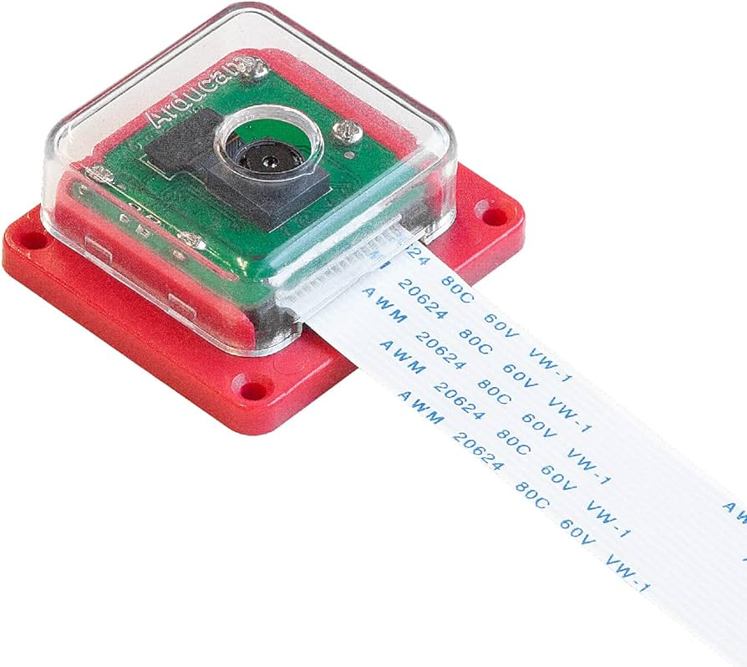
Project Overview
Developing a FPGA-based video pipeline
MIPI-connected “off the shelf” camera module
Video monitor
Augmented video → active displayport cable → monitor
Software executes in Linux OS
STRETCH GOAL: Pass video through a machine learning algorithm
IMX219 Image Sensor

Slide 4
Vocabulary
IMX219 image sensor: camera
MIPI: mobile industry processor interface
CSI: camera serial interface
D-PHY: physical communication layer
VDMA: video direct memory access
DDR: double data rate (memory)
FPGA: field programmable gate array
PYNQ: python productivity for Zynq (python embedded systems developers)
Ultra-96 FPGA Board
‹#›

Slide 5
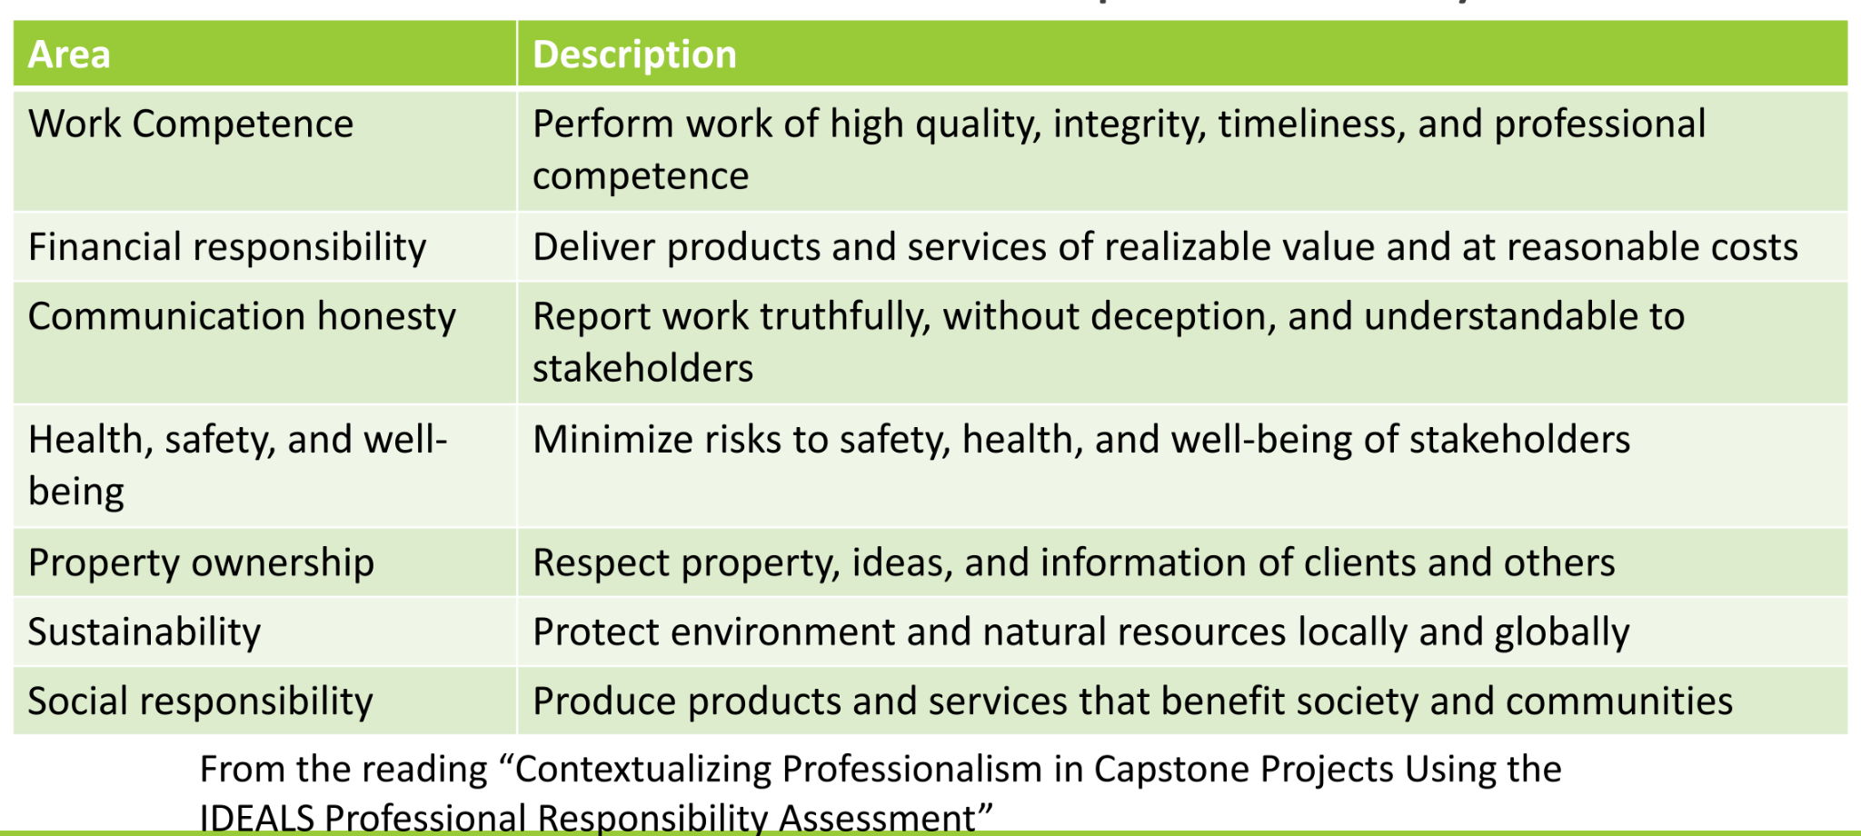
IDEALS Professional Responsibility

Slide 6
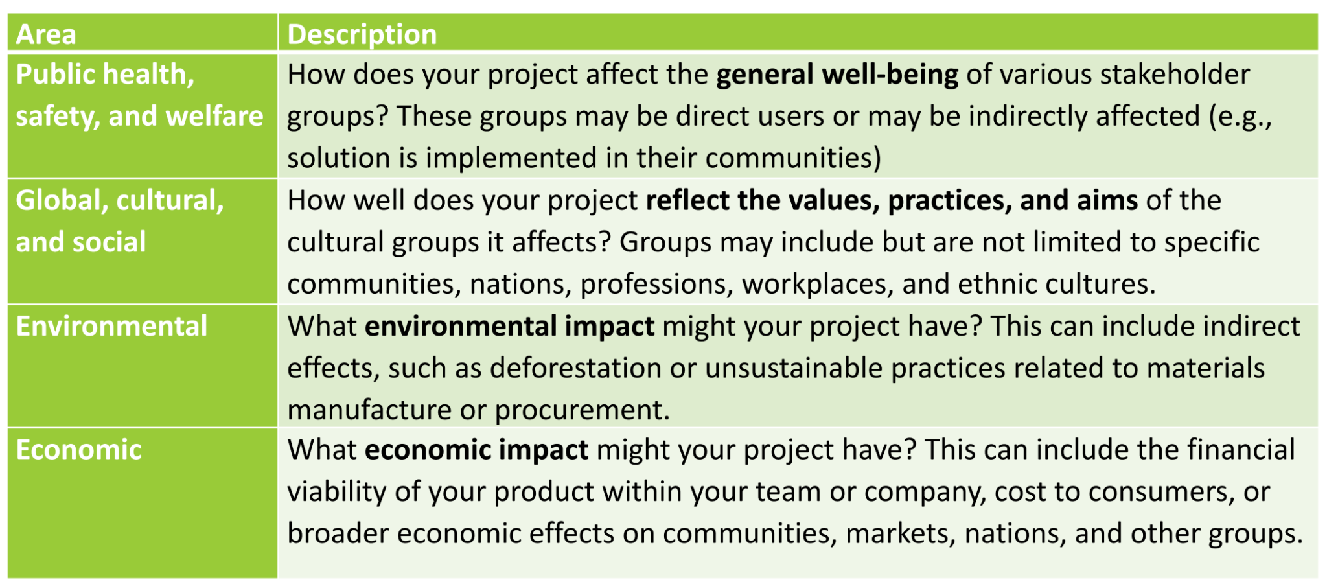
Broader Context Considerations

Slide 7
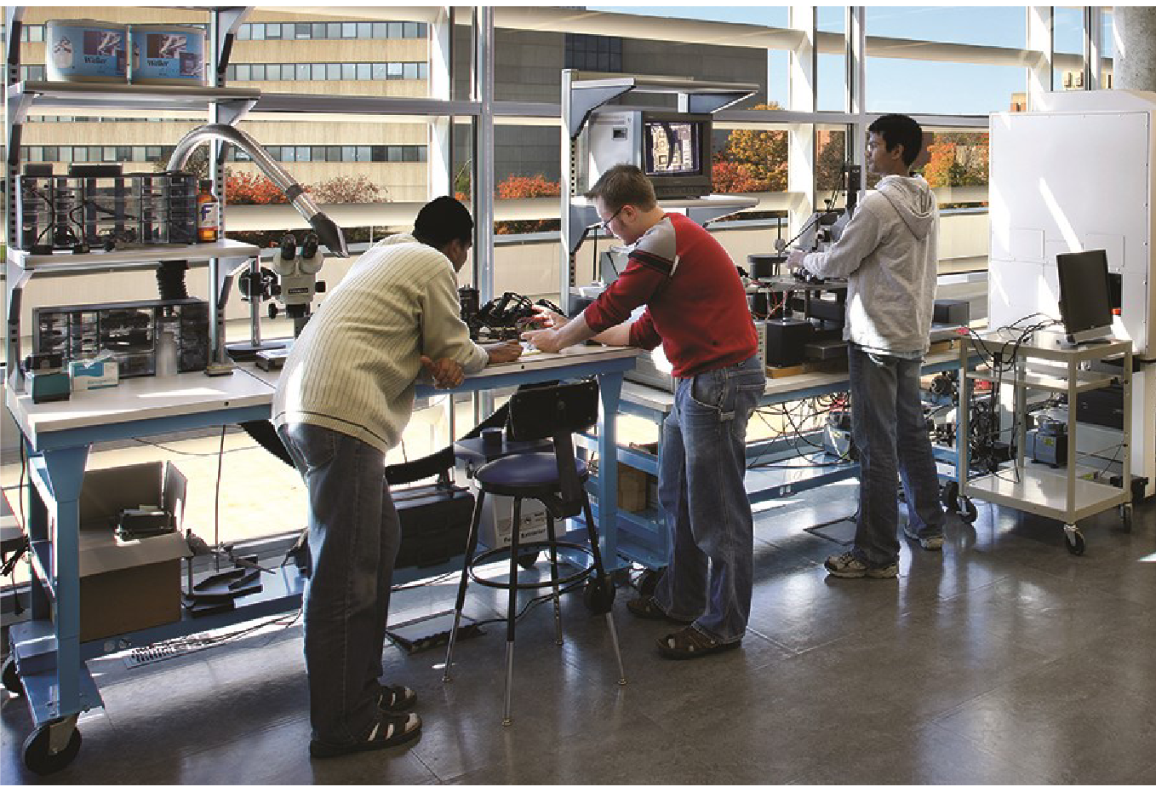
Communication Honesty
Why is communication honesty relevant to our project?
Effective communication between all team members, client, and faculty advisor is crucial for project success
Ensure we meet deadlines
Engineers Collaborating

Slide 8
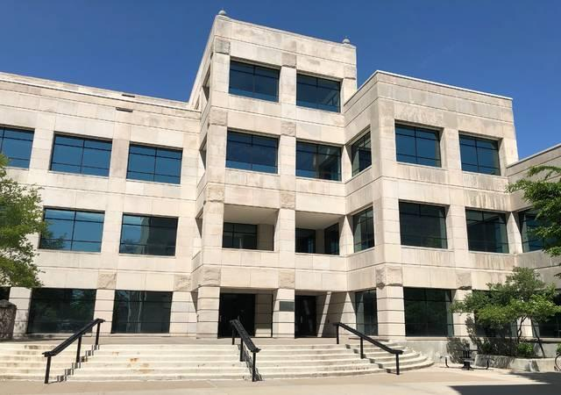
Communication Honesty (continued)
Team’s approach to communication honesty:
Meetings
Client
Advisor
Team
Content
Project status
Ask/clarify questions
Receive feedback on past week accomplishments
Understanding of project’s hardware/software tools
Telegram
ISU Durham Hall

Slide 9
Communication Honesty (continued)
Team’s approach to communication honesty:
Advisor meetings
Discuss project status
Ensure team is on schedule
Make sure team understands project hardware/software tools
Compile new questions to ask client for clarification
ISU Durham Hall

Slide 10
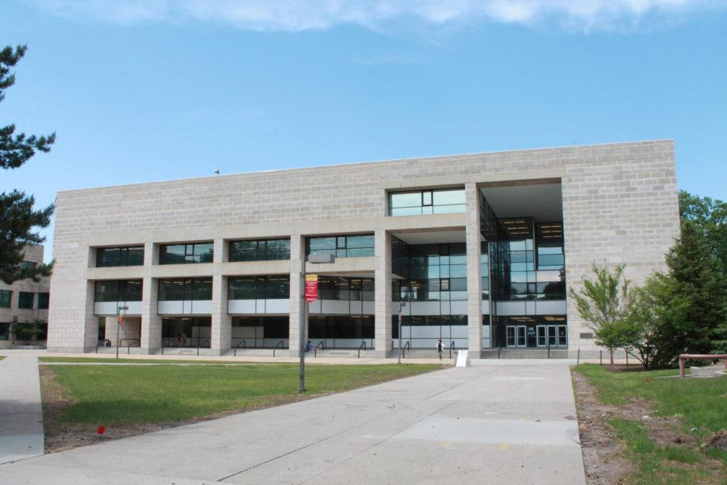
Communication Honesty (continued)
Team’s approach to communication honesty:
Team meetings
Discuss project status
Work on project as a team or individually
Complete class assignments during and outside of class
ISU Parks Library

Slide 11
Communication Honesty (continued)
Upholding ethical and professional responsibilities for communication honesty
Team members report project work with each other, the client, and advisor in accordance with the NSPE Code of Ethics
Work is reported
Truthfully
Understandable to client, advisor, and team members

Slide 12
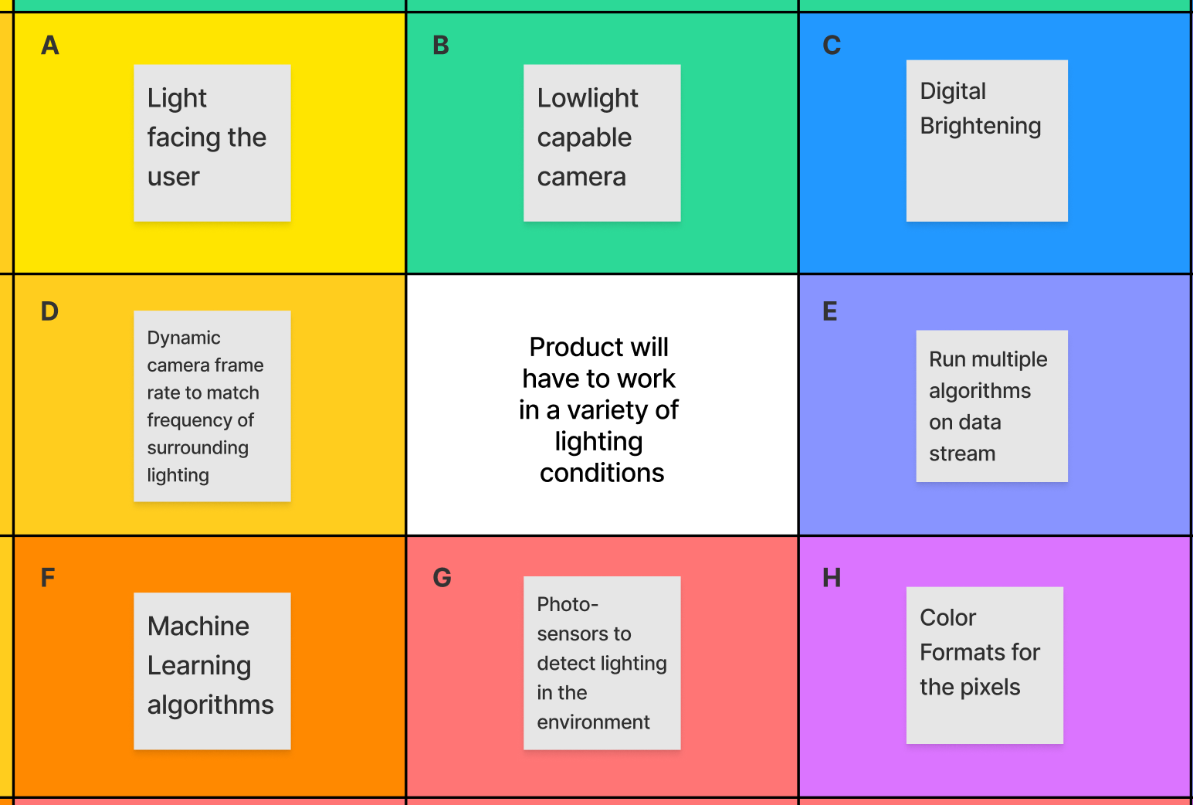
Work Competence
Why work competence is relevant to the project?
Delivering a quality product in a timely manner
Need relevant skills to deliver a functioning product according to the requirements & specifications
Example: meeting lightning conditions
Project Lotus Blossom

Slide 13
Work Competence (continued)
Team approach to work competence
Client meetings
Project block diagrams
Gantt chart for project workflow timeline
Integrating previous senior design project
Utilizing a higher quality image sensor
IMX219 instead of OV5647
image sensor
IMX219 Image Sensor

Slide 14
Work Competence (continued)
Team approach to work competence
Advisor meetings
Monitor team project status
Suggest ways of improving project efficiency
Building a Linux image from scratch
Utilize Vivado and ILA (Integrated Logic Analyzer) to debug

Slide 15
Work Competence (continued)
Team approach to work competence
Team meetings
Individual research on specific subsystems
Presentations for group members to see how the pipeline works
Research into existing PYNQ video pipeline documentation online
Discuss findings with all team members

Slide 16
Work Competence (continued)
Upholding ethical and professional responsibilities for work competence
Team will modify its work competence approach to ensure the product is completed in a timely manner and of a reasonable quality in accordance with the NSPE Code of Ethics
The team does not have years of hardware design experience working with FPGAs

Slide 17
Work Competence (continued)
To ensure project is complete on schedule, the team will:
Consult ECpE faculty for technical guidance
Keep project documentation for use after the summer
Ask client and advisor for feedback

Slide 18
Potential Ethical Issue Uncertainties
Ethical issue uncertainties
Sustainability: how does this project relate to sustainability and protecting natural resources locally and globally?
Power consumption: Ultra-96 heating environment
Data usage: memory usage
NSPE Sustainability Definition

